Slide 1
IFLA Green Library Award 2021

Slide 2
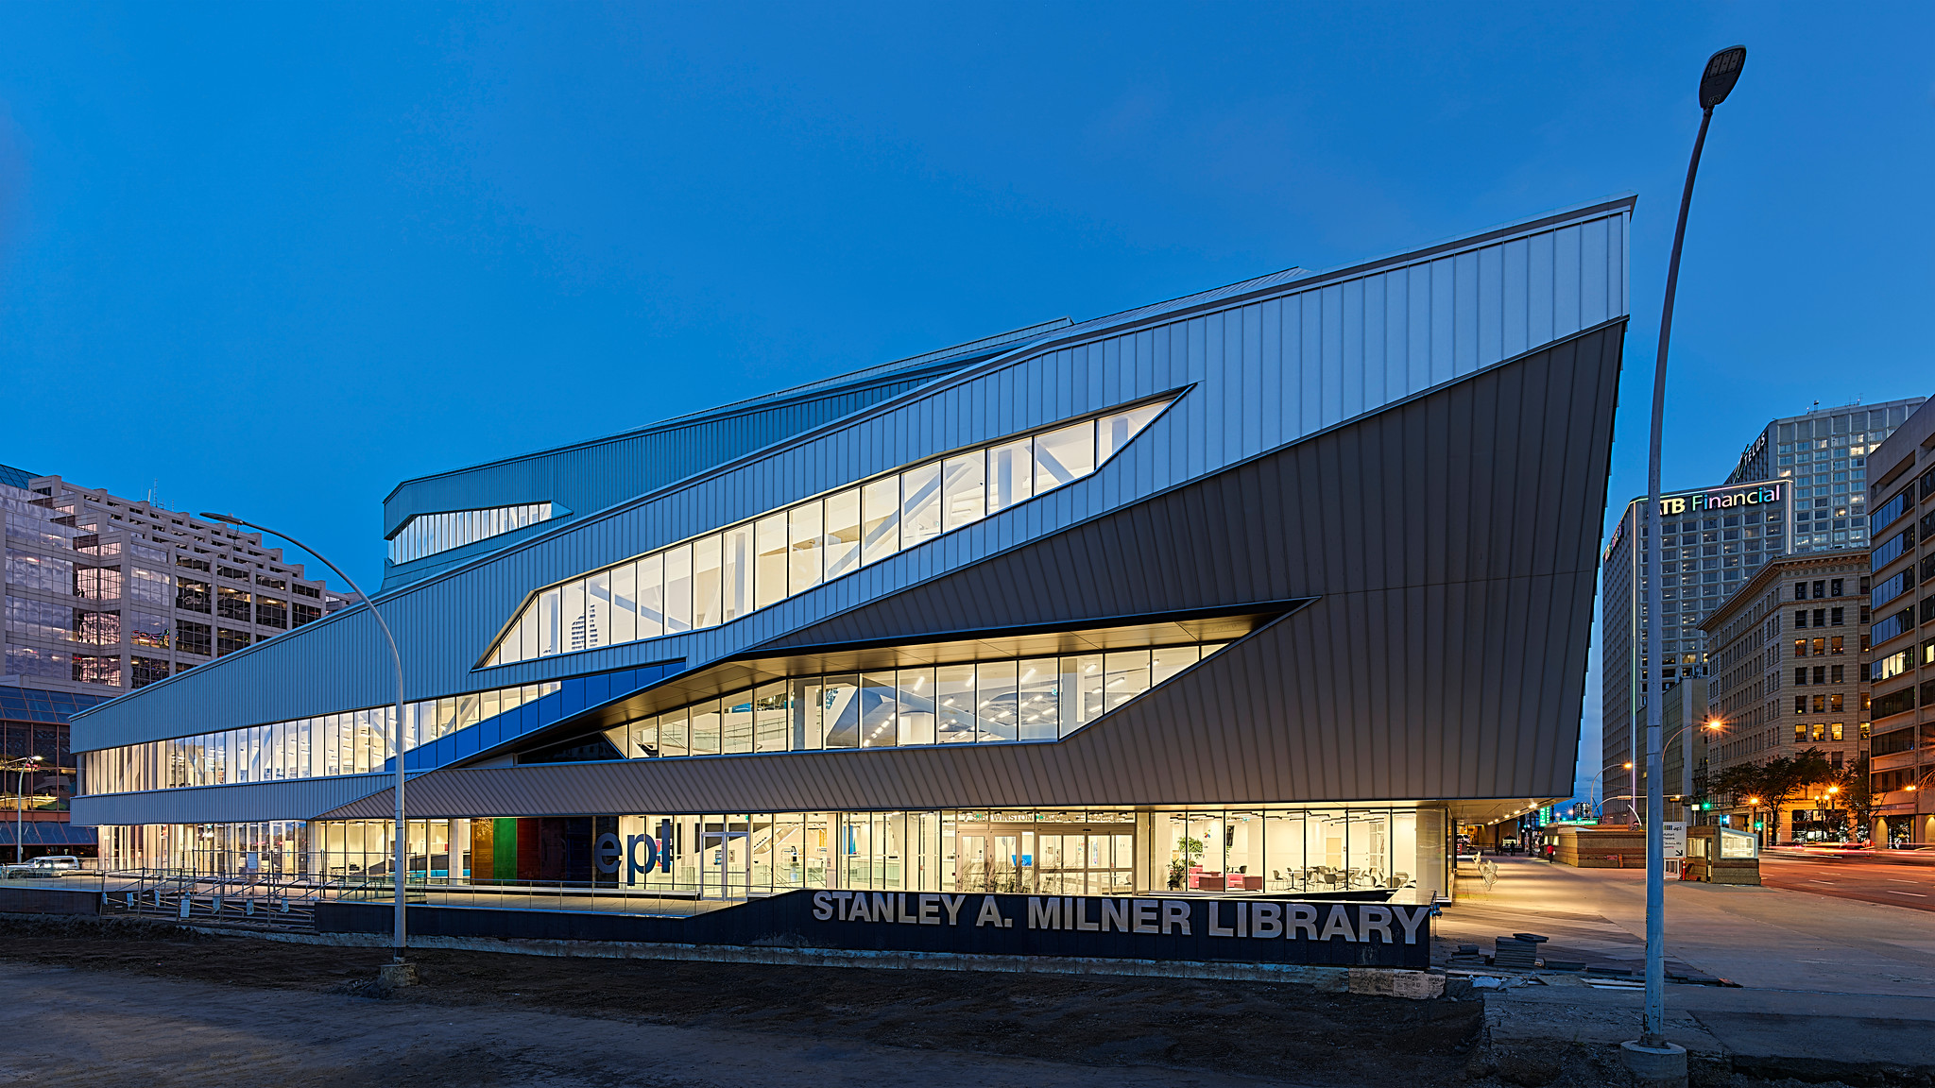
STANLEY A. MILNER
EDMONTON, ALBERTA CANADA
EDMONTON PUBLIC LIBRARY​
​
IFLA Green Library Award 2021​
​

Slide 3
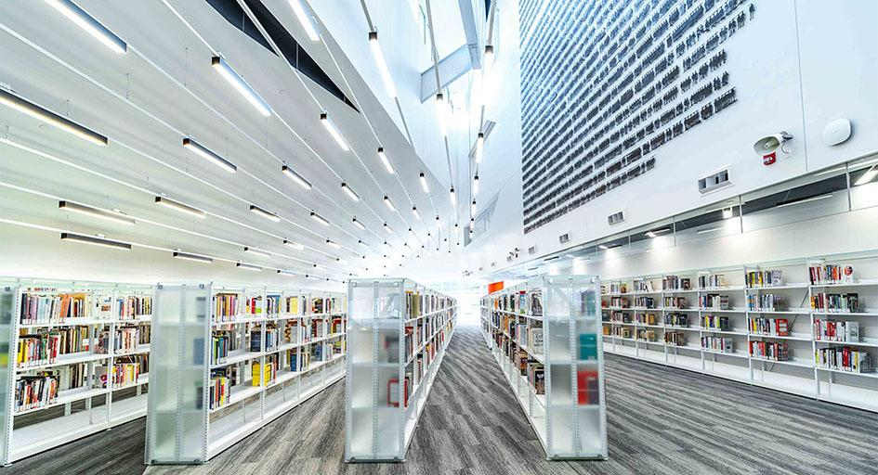
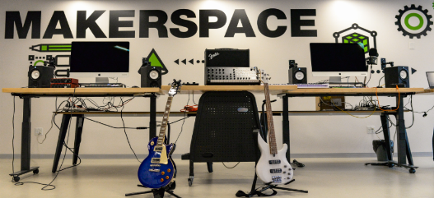
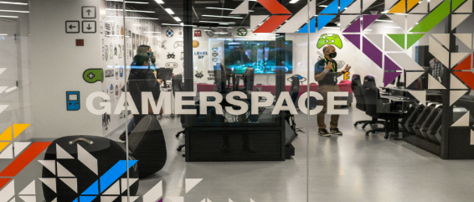
VISION & COMMITMENT
The Edmonton Public Library is committed to sustainable development and providing facilities that have strong design emphasis on human and environmental health, proven by one-third of EPL libraries achieving LEED status. Over the past 13 years we have built 8 LEED certified libraries with EPL's flagship, Stanley A. Milner Library (over 225,000 square feet), our 9th LEED project once certified. Our vision and commitment is to continue our green path and seek LEED certification for all new library builds.
Our Vision: EPL is the gathering place for people and ideas, enabling a lifetime of learning, engagement and possibility for every Edmontonian.

Slide 4
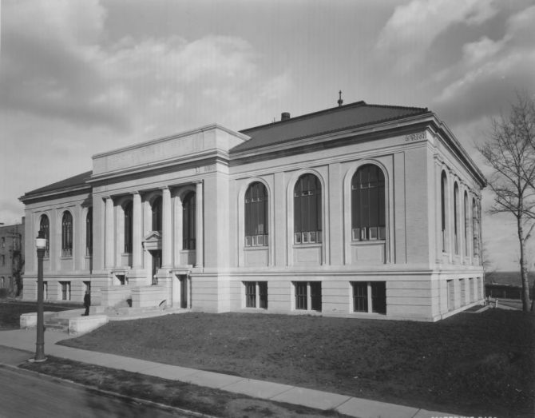
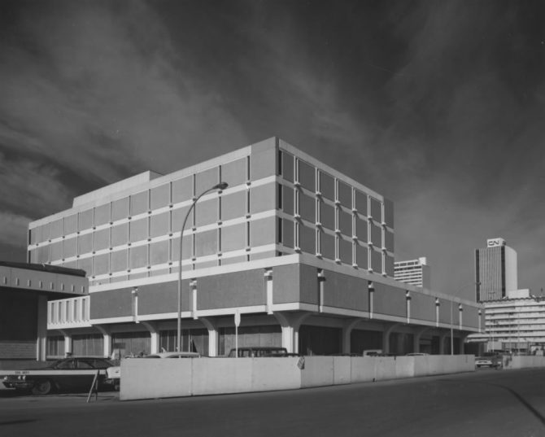
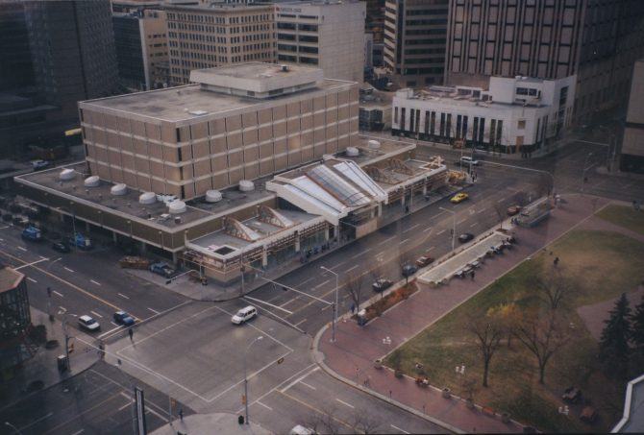
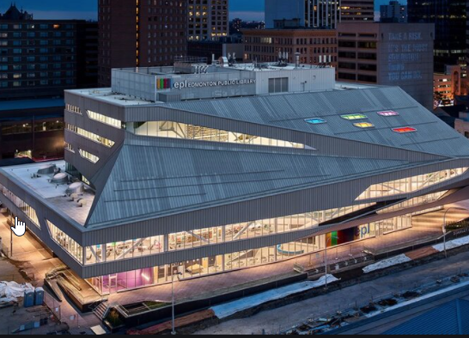
STANLEY A. MILNER LIBRARY REVITALIZATION
EPL's original central library opened in 1967 and is the heart of EPL and Edmonton's downtown receiving over 1.2 million visits each year prior to the renovation.
In the fall of 2011, City Council approved funding for the revitalization and renewal of the Stanley A. Milner Library. After over 50 years in operation, many building components had reached the end of their life and required significant changes to ensure energy efficiency, code compliance as well as meeting the service needs of a modern library. Requirements included repairing the deteriorating building envelope, completing structural upgrades, asbestos remediation, improving accessibility and performing substantial interior renovations. The end result is a 227,732 square foot beautiful learning and gathering space that includes a collection of over 150,000 items, a children's library, adult and children's makerspaces, computer lab, early learning and care centre, gallery spaces, an Indigenous gathering space, not-for-profit office suites, 32,928 square feet of program/meeting rooms, a two-story digital display wall, a theater and more.
The revitalized Milner Library which opened in 2020 will help build a thriving, vibrant downtown, and serve as a key component in Edmonton's economic prosperity.
1925
1967
1996
2020

Slide 5
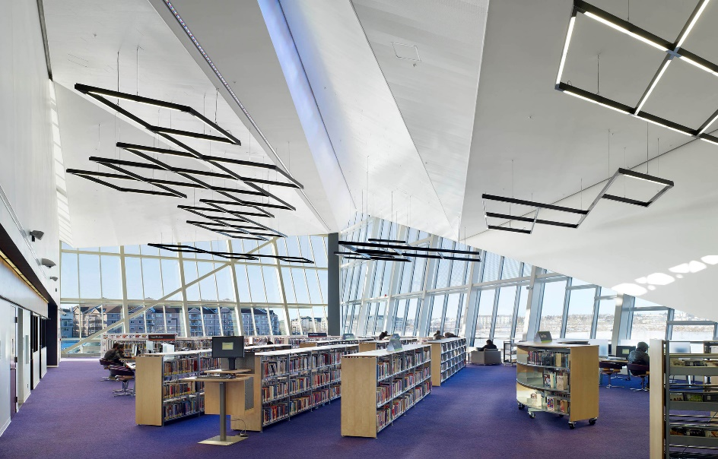
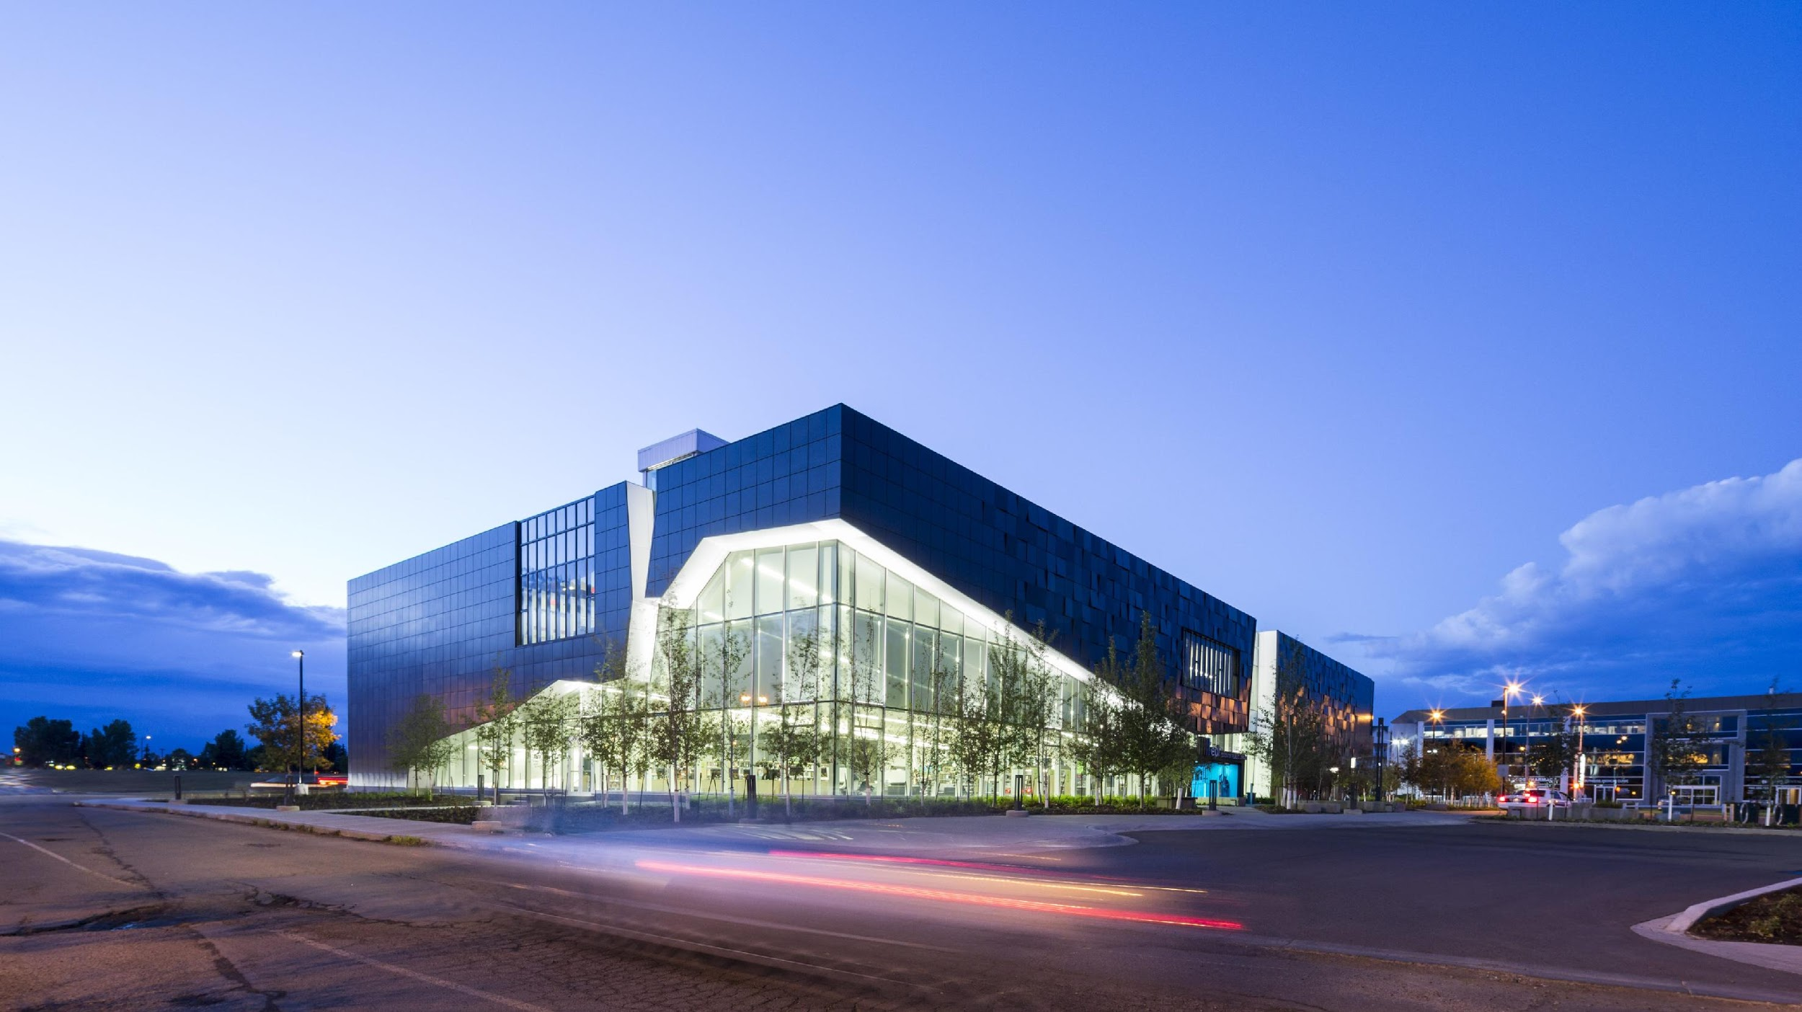
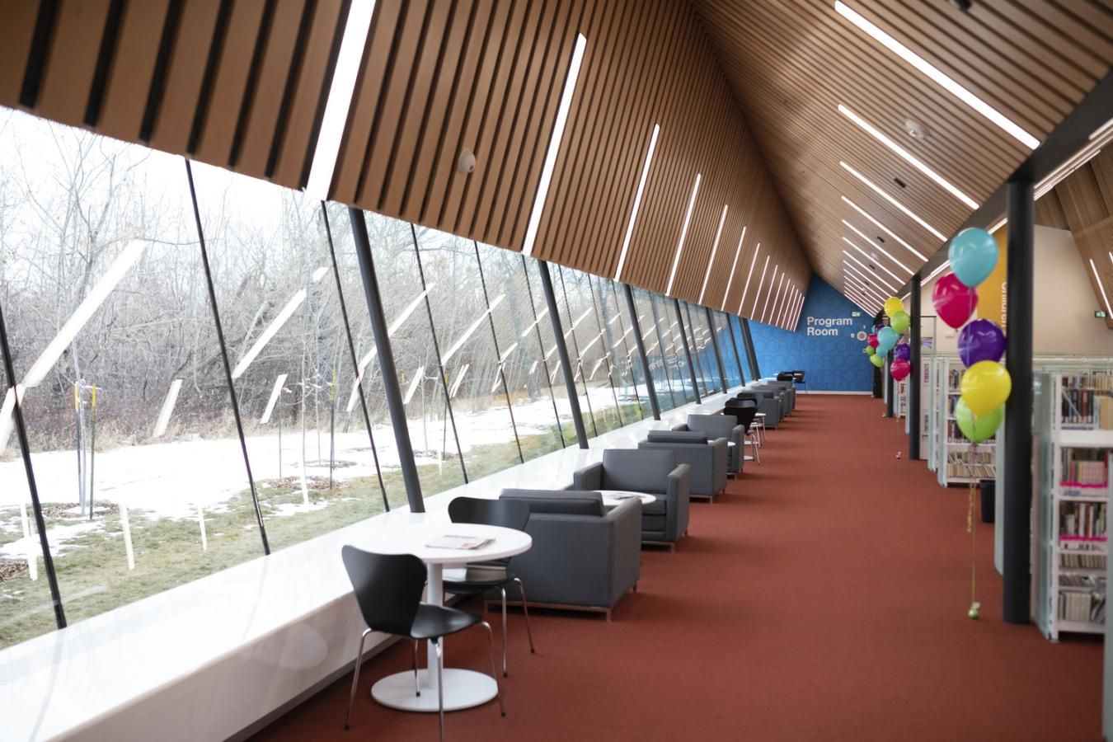
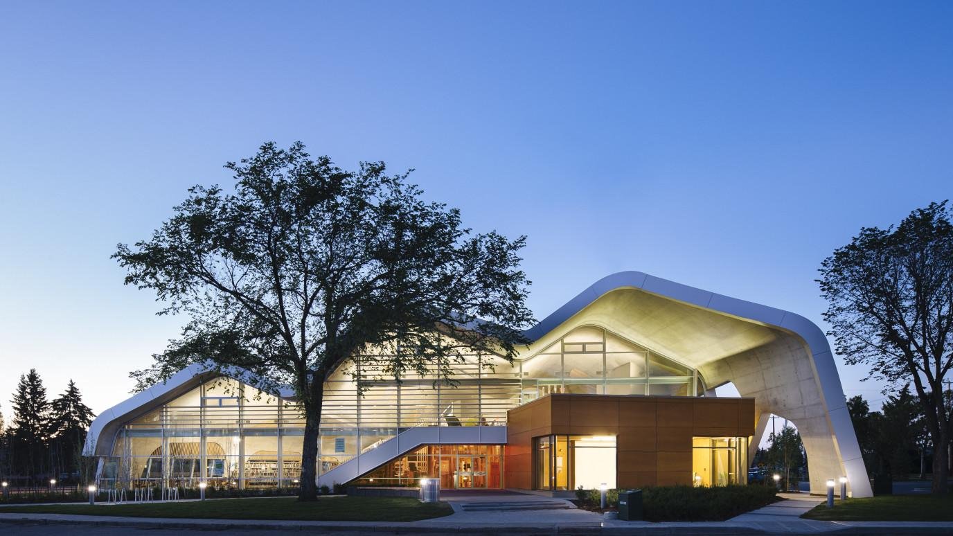
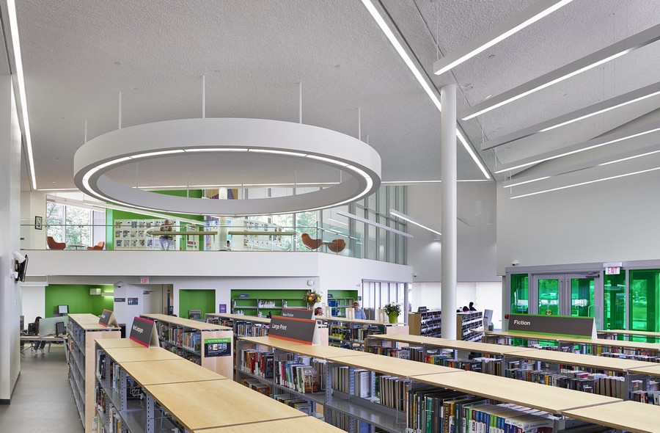
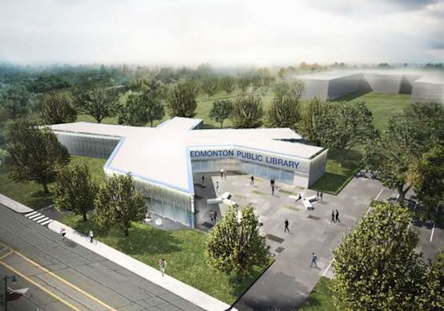
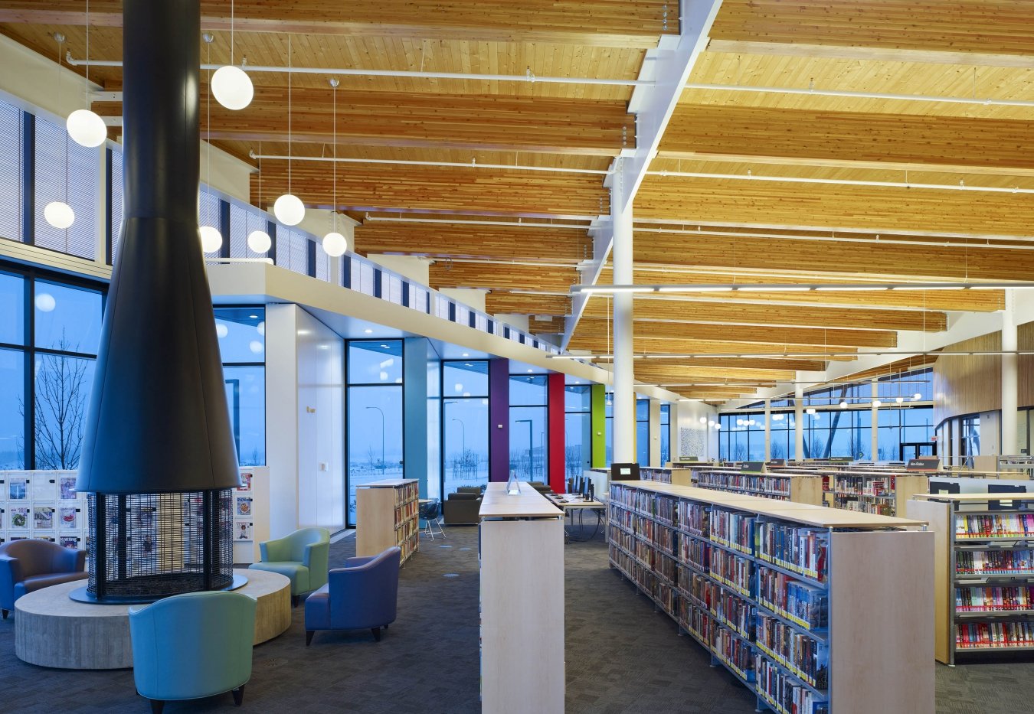
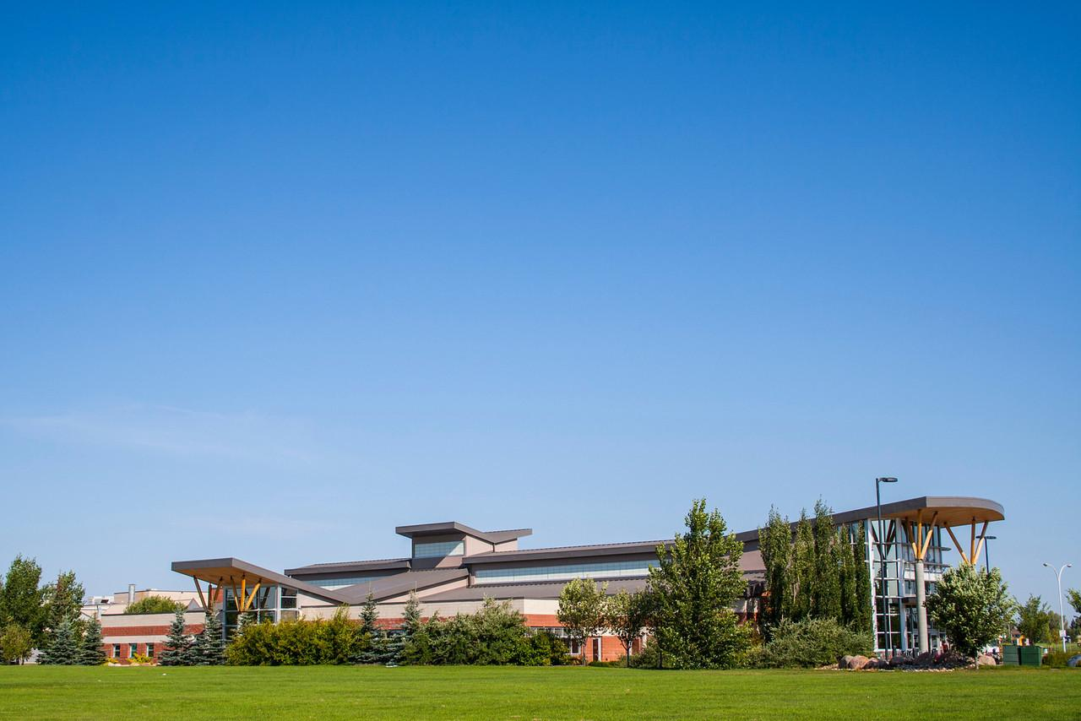
LEED
CLAIREVIEW / SILVER
EPL CERTIFIED BUILDINGS​
​
MILLWOODS / GOLD
JASPER PLACE / SILVER
CAPILANO / SILVER
HIGHLANDS / SILVER
MEADOWS / SILVER
CALDER / SILVER
LOIS HOLE / SILVER

Slide 6
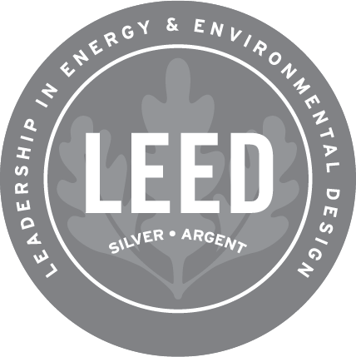
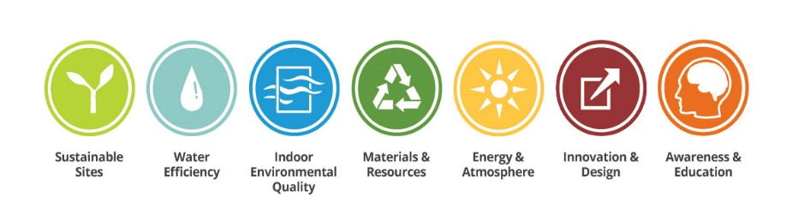
SUSTAINABILITY GOALS
EPL's core values perfectly align with LEED principles to achieve high standards in each LEED category. EPL partnered with the City of Edmonton with a goal of LEED Silver for the Stanley A. Milner Library Renewal Project.
Sustainable Goals Summary
Reduce water/electrical/gas consumptions with energy efficient equipment and fixtures | Continue to enhance our refrigeration management program
Implement a 3-stream waste collection program (Waste/Recycling/Organics) and provide education material to customers on the program | Divert waste from the landfills by recycling constructions materials and reusing materials for the new building wherever possible
Provide car charging stations and bike racks to promote alternative modes of transportation | Ensure all new construction materials are low-emitting
Install Direct Digital Controls on major building systems to monitor energy usage and thermal comfort of occupants | Maximize the use of materials manufactured and / or harvested within an 800 km radius of the site
Promote green and sustainable education and providing tours of our LEED certified buildings | Maintain function and aesthetics of exterior building lighting while reducing light pollution
LEED CATEGORIES

Slide 7
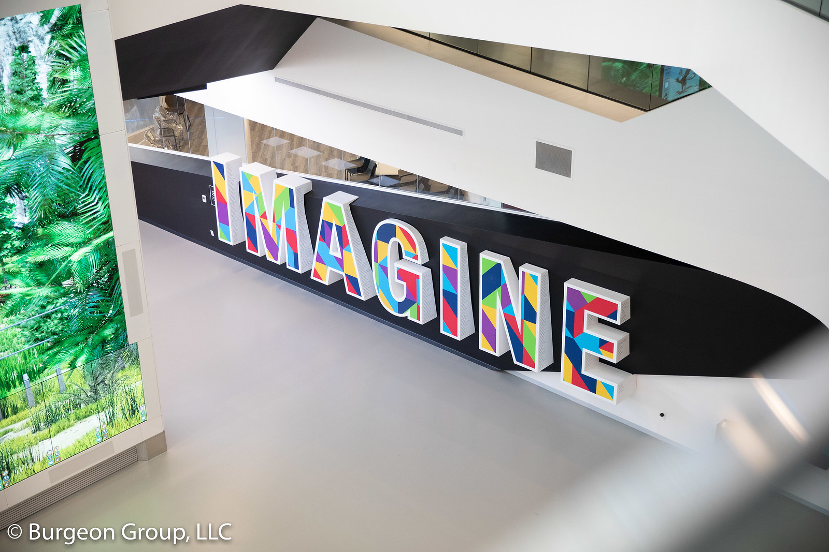
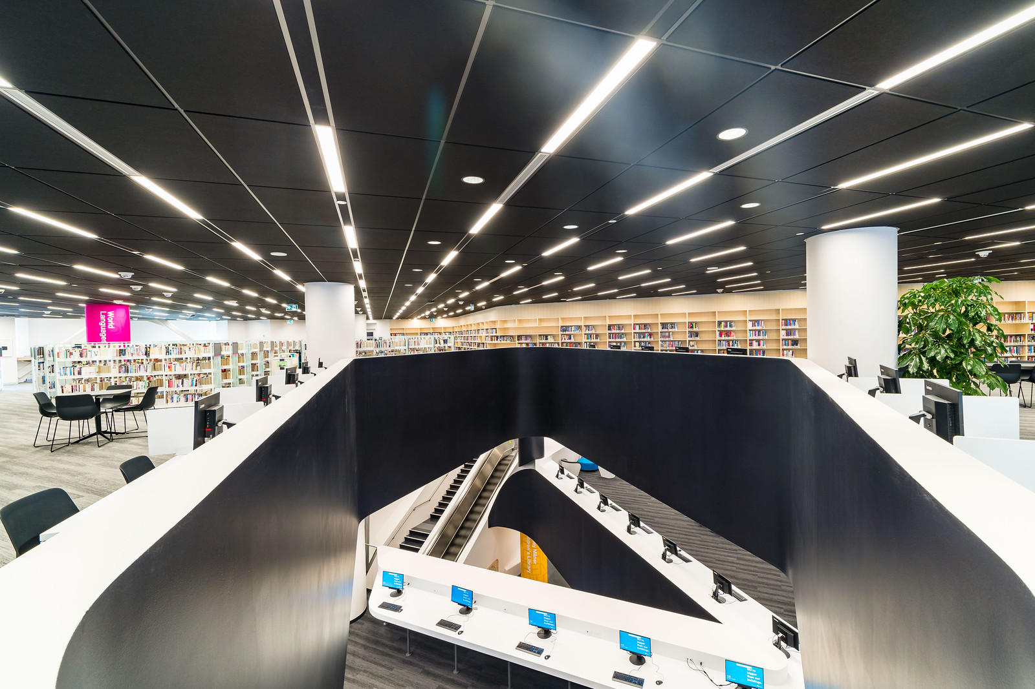
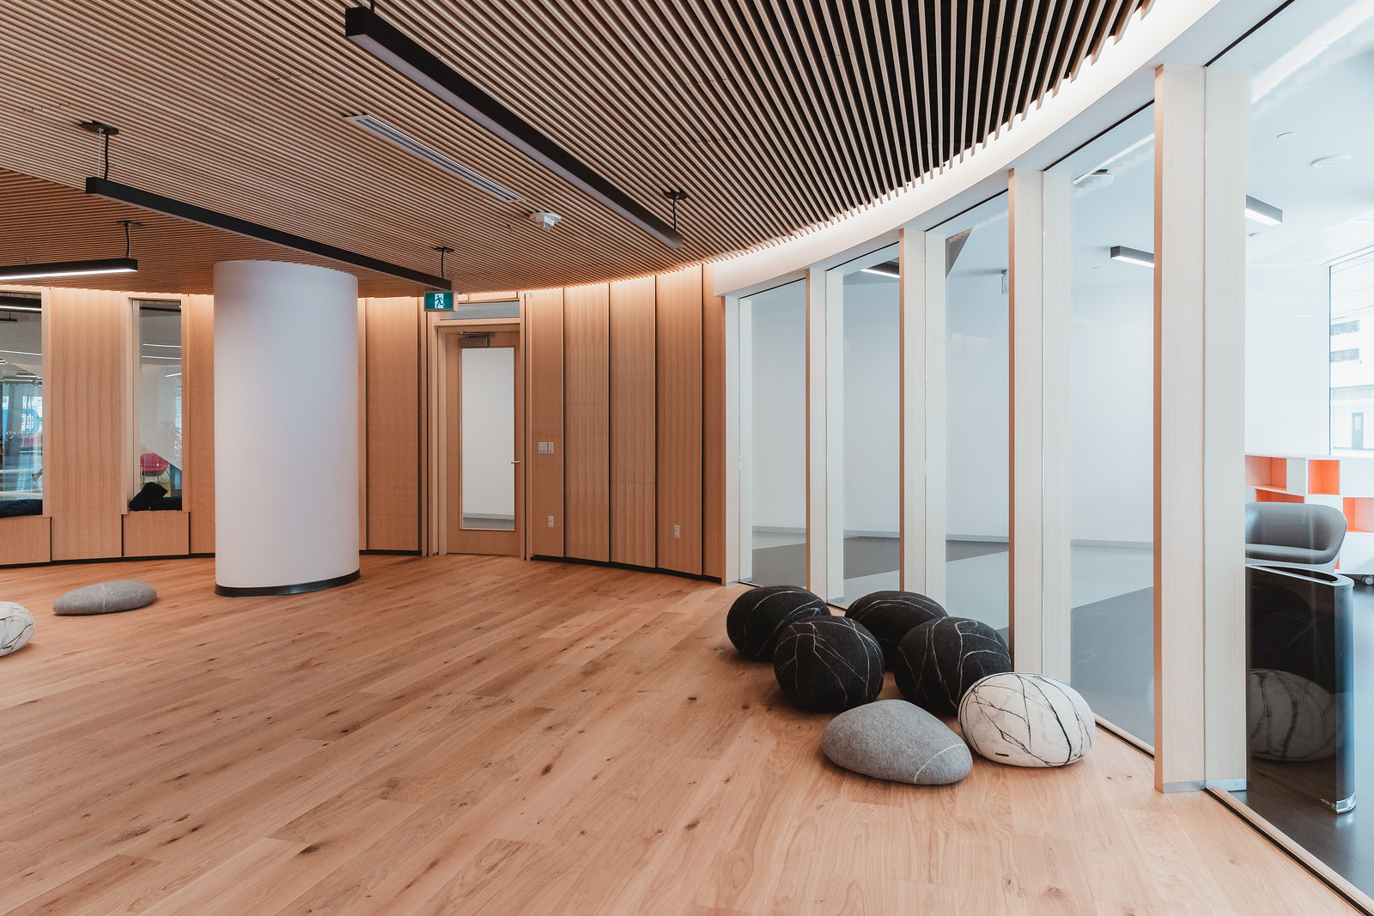
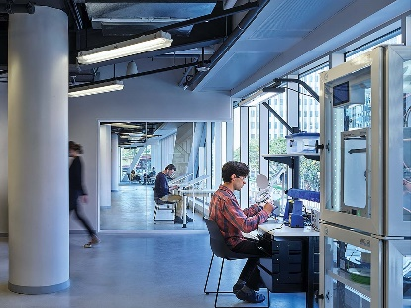
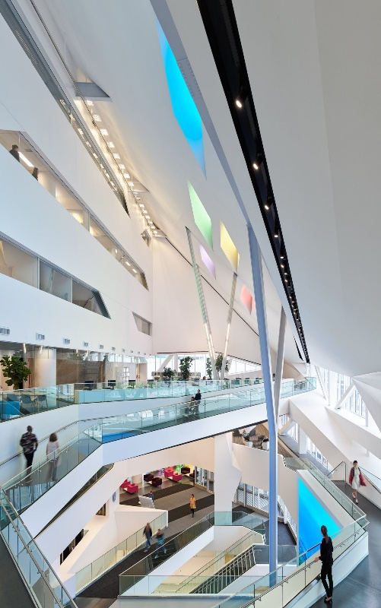
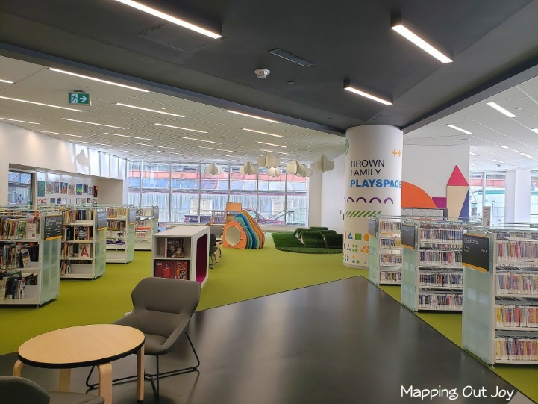
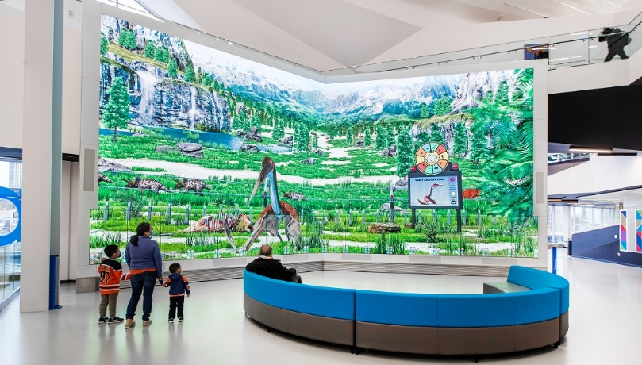
VISUALS & VIDEOS
IMAGINE WALL
Virtual Tours
Milner Library - Introductory Virtual Tour
Milner Library - Architecture & Engineering Spotlight
NEW FLOOR OPENINGS THROUGH 3 LEVELS
FABRICATION LAB
PÎYÊSÎW WÂSKÂHIKAN (INDIGENOUS SPACE)
VIEW FROM 3rd FLOOR
DIGITAL DISPLAY WALL
CHILDRENS LIBRARY

Slide 8
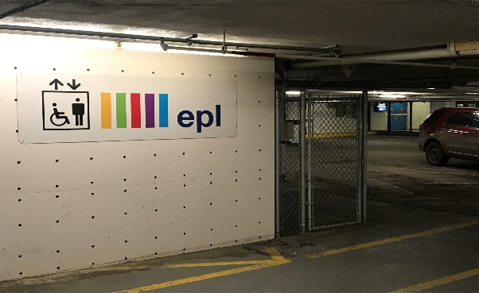
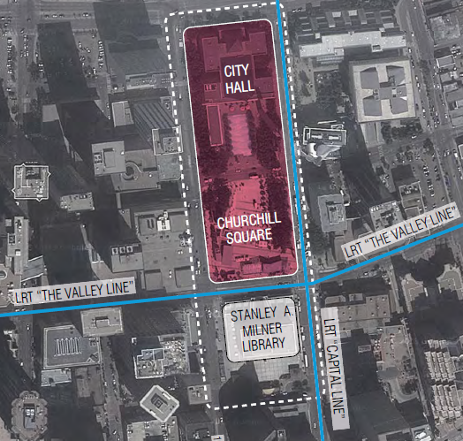
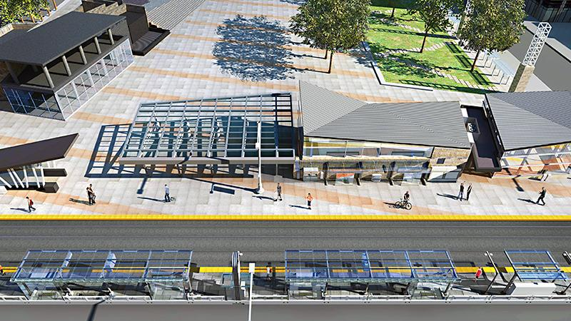
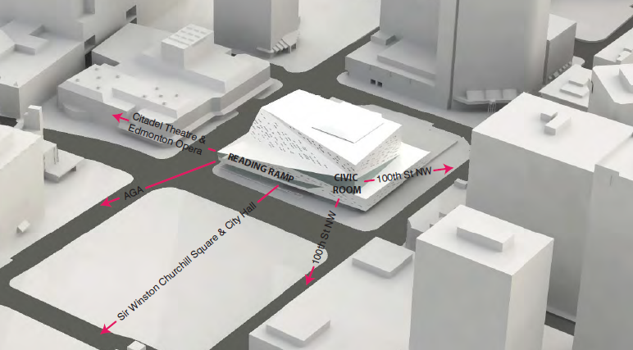
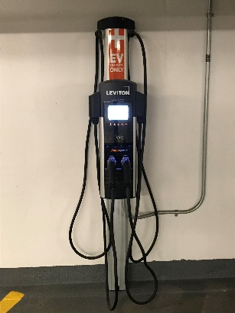
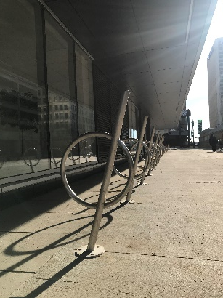
ACCESS
NEW PARKADE ELEVATOR
Promoting Travel & Commuting
The Milner Library is nestled at the core of Edmonton’s thriving downtown providing our users with great connections to the surrounding communities and businesses.
To help ensure easy public access, the library is within close distance to the city's Light Rail Transit (LRT) system with direct connections from the lower level of the library. The library is connected to the rest of downtown through an extensive underground pedway system. Soon, an LRT stop and transit track (with bike lane running alongside) will be in front of the library. As part of the Milner renewal project, a new elevator was included to address accessibility issues from the parkade levels up to the library.
Encouraging sustainable modes of transportation, our library has over 30 bicycle stalls and free pubic access to 4 designated underground electric vehicle charging stations.
DOWNTOWN SITE
FUTURE LRT LINE
COMMUNITY CONNECTIVITY
BIKE RACKS
EV CHARGING STATION

Slide 9
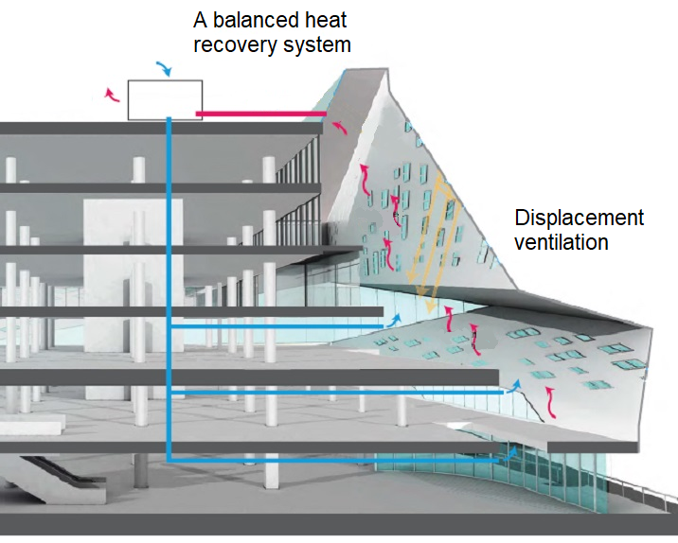
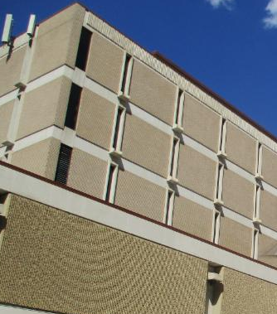
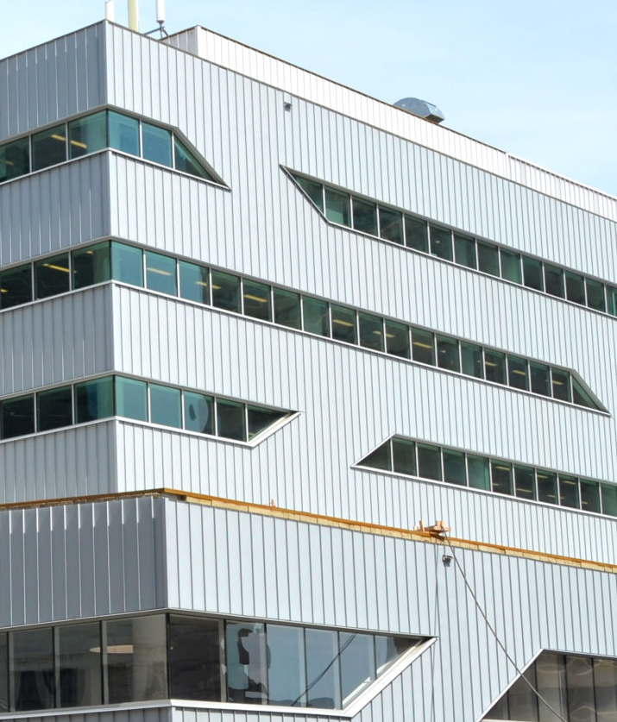
DESIGN
Building Design
An additional 450 windows/skylights were installed to bring in as much natural light as possible
All new energy efficient lighting systems and HVAC/R
The floorplan was designed to provide adaptive and versatile spaces
Low emitting materials were selected for construction including paints, flooring, wood, adhesives, and sealants
High albedo exterior materials were used to reduce heat island effect including Azengar Zinc exterior (Solar Reflectance Index of 39)
A balanced heat recovery system
HVAC systems and building envelope designed to comply with ASHRAE Standards to achieve a high level of thermal comfort for human occupancy
Occupational wellbeing has been achieved through accessibility, acoustics, and air quality.
NEW MILNER
PREVIOUS MILNER
SW corner of the library - window quantities along with overall window sizes were dramatically increased.

Slide 10
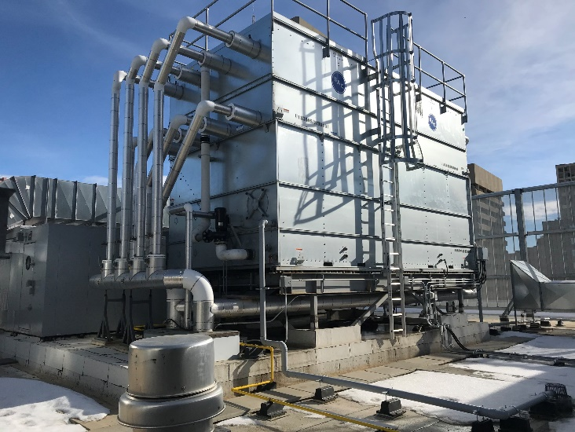
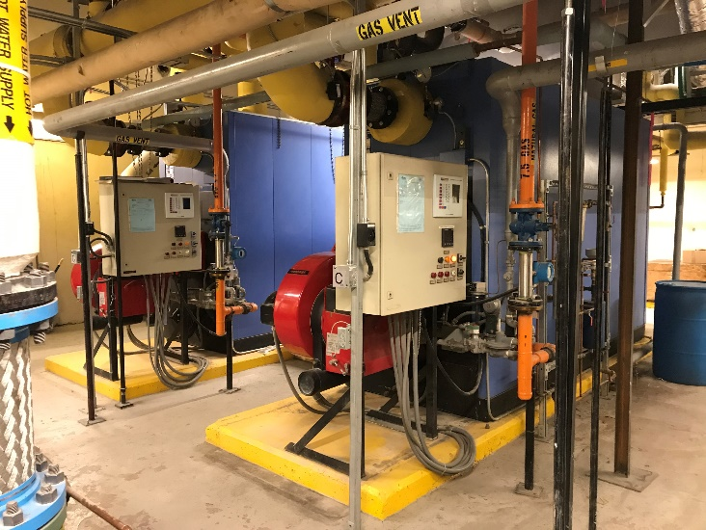
ENERGY & EFFICIENCIES
By installing new highly efficient equipment, controls and building envelope, EPL was able to reduce overall consumption of utilities when compared to our previous building
Energy and Atmosphere
Enhanced refrigerant management for HVAC/R equipment
Energy efficient design provides an estimated 19% annual electrical savings in overall power consumption
Energy-efficient heating system provides an estimated 25% annual natural gas use
Light pollution reduction
LED lighting systems installed in the public spaces and office areas
Building controls installed throughout the facility to manage HVAC equipment and lighting systems
Water Efficiency
Low flow fixtures deliver an estimated 32% in water use savings
Motion activated washrooms and sinks installed

Slide 11
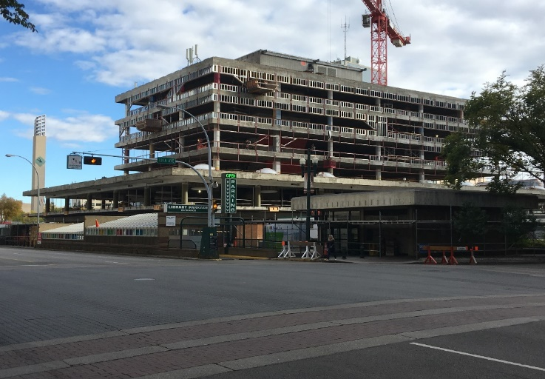
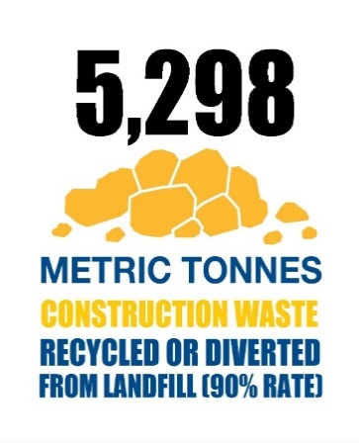
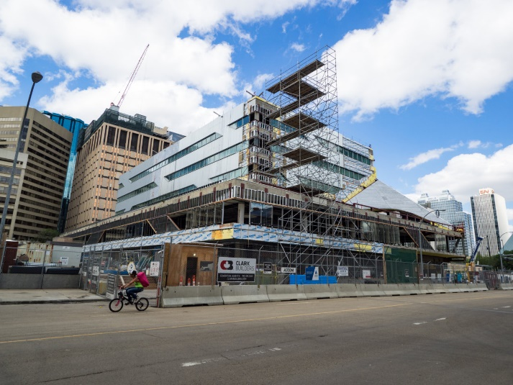
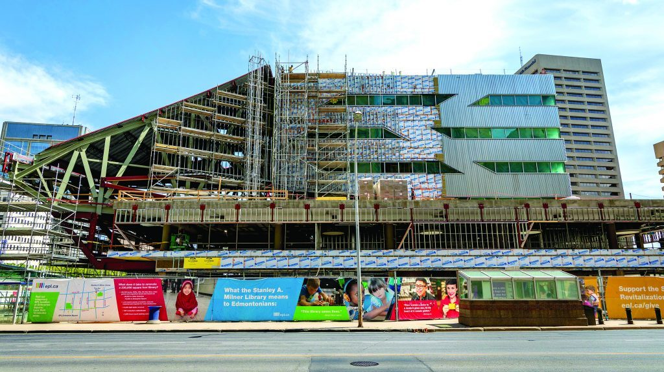
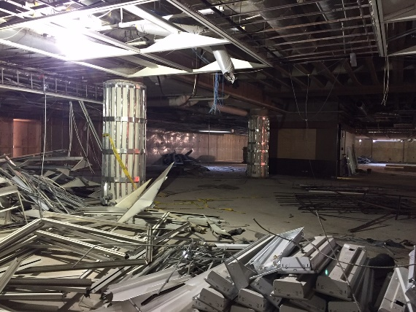
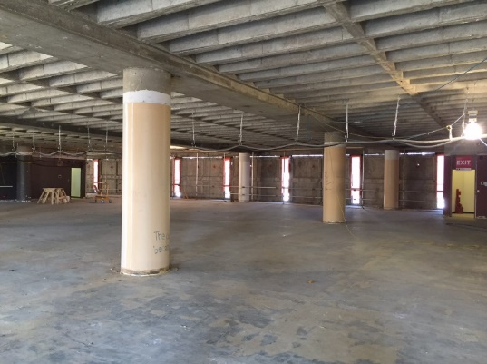
REUSE & RECYCLE
Waste Diversion
EPL reused approximately 60% of the existing structure.
In total, building materials used had a combined 22% recycled content.
90% of construction waste was recycled or diverted from the landfill.

Slide 12
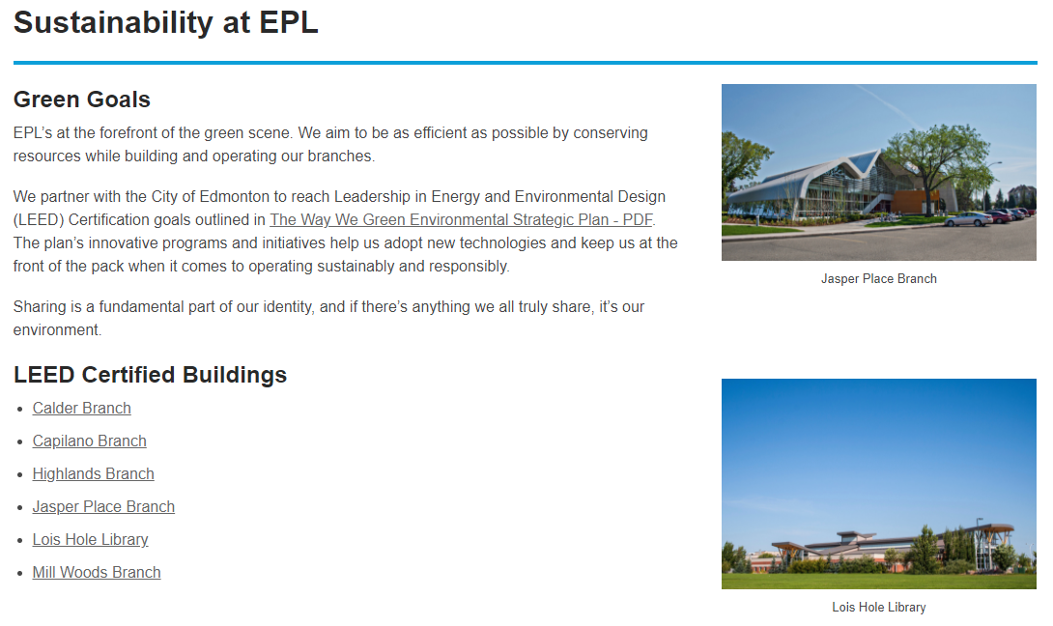
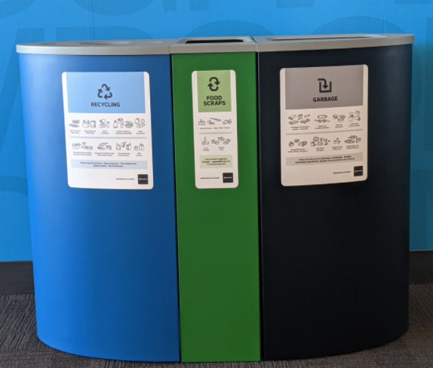

EDUCATION
Link to Sustainability at EPL
LEED Tours
To help educate the public on EPL's sustainability and green practices we developed an in-person and virtual tour of the Milner Library in collaboration with our architects and construction team. Customers can also access epl.ca to learn about sustainable practices and book staff-guided tours in any of our LEED facilities.
Waste Management
EPL is also working to rollout a new waste management program that will include pickup for waste, recycling and organics. Along with this initiative we plan to create education signage and posters that will help our customers understand how and what can be recycled in the libraries. Educational signage will also include how The City of Edmonton’s waste program works across the city.
Book a Tour

Slide 13
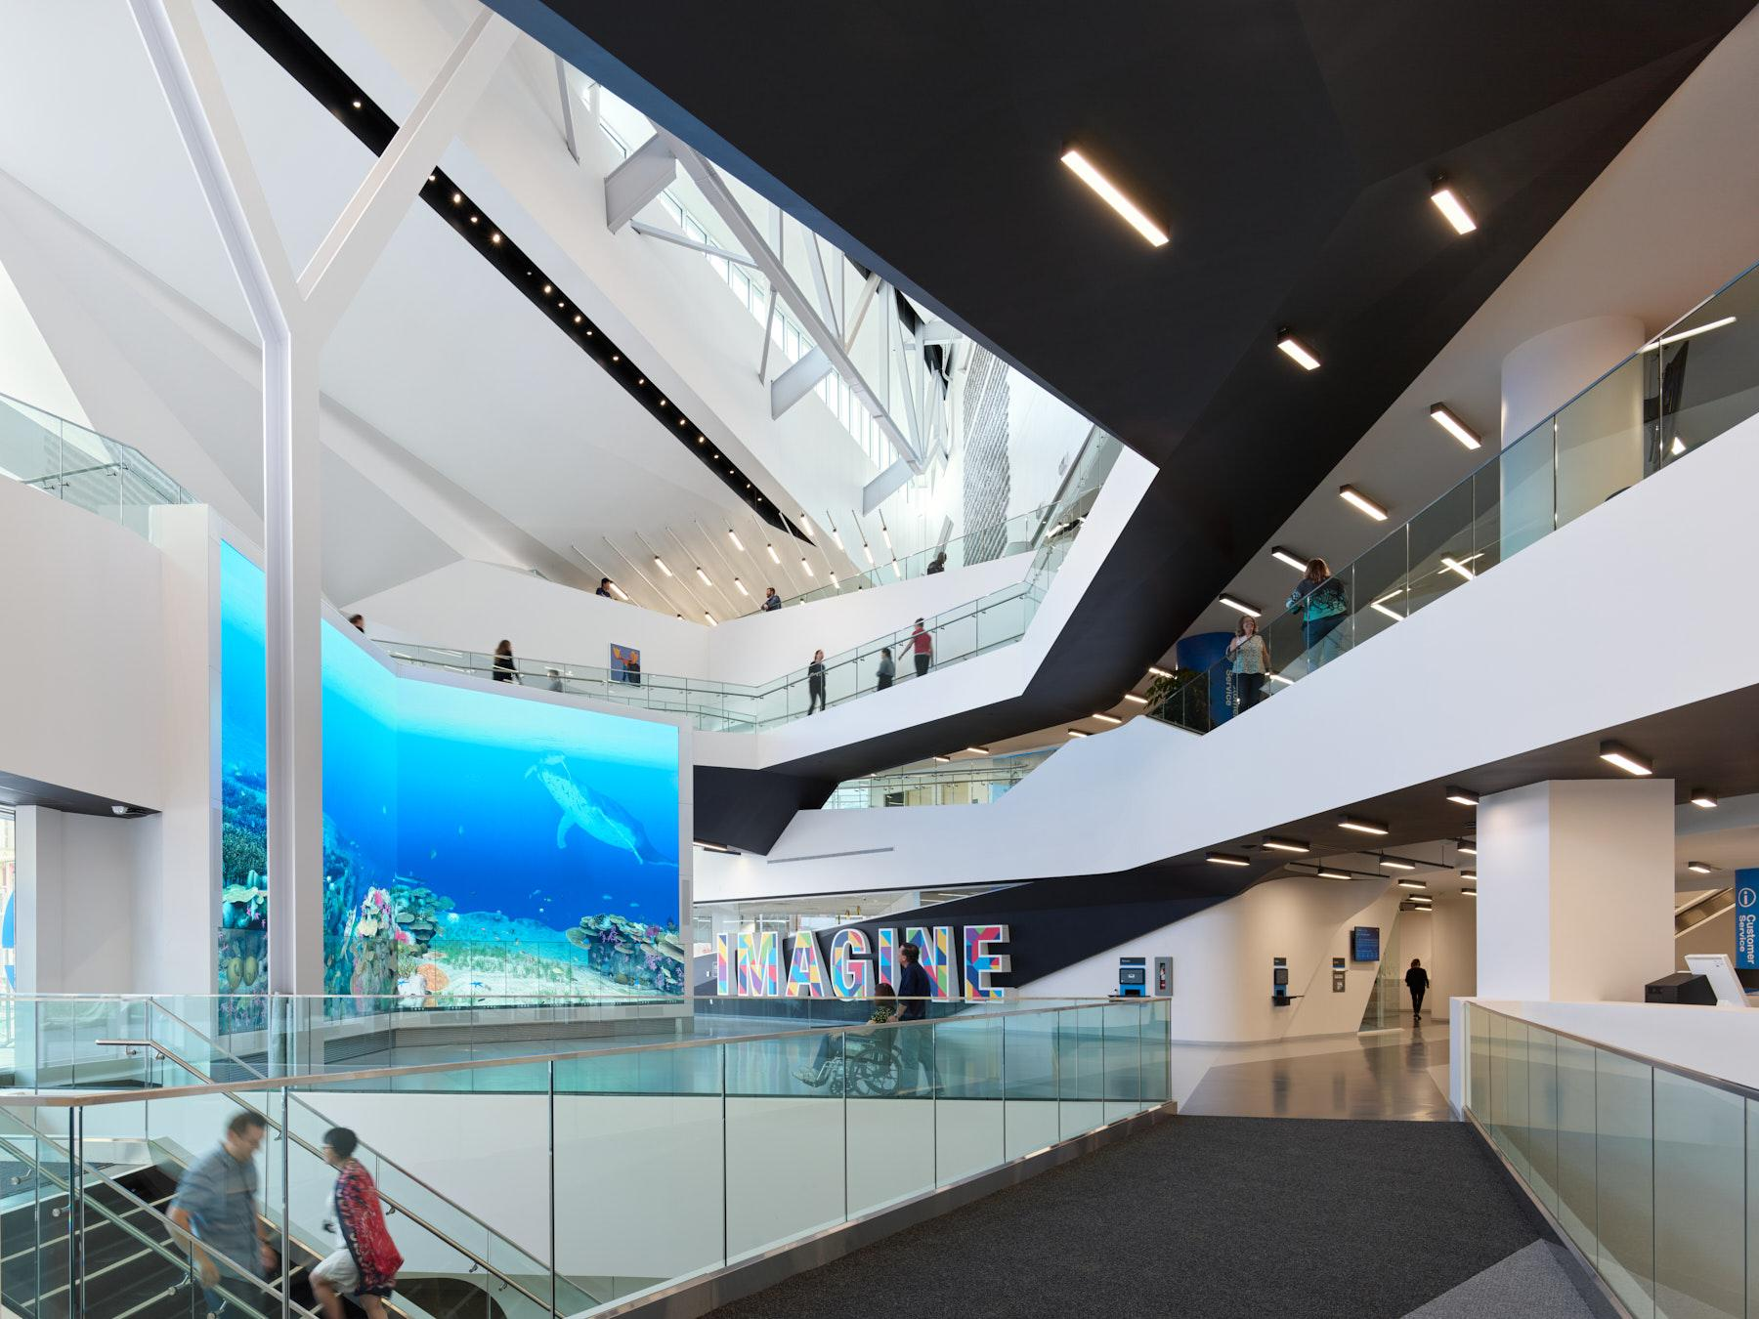
Thank You!
Thank You!

